Slide 1
Capstone Project: Train an AI Agent to Play Flappy Bird
Key facts:
Flappy Bird is a mobile game developed by Vietnamese video game artist and programmer Dong Nguyen, under his game development company dotGears. The game is a side-scroller where the player controls a bird, attempting to fly between columns of green pipes without hitting them. Nguyen created the game over the period of several days, using a bird protagonist that he had designed for a cancelled game in 2012.
Release date: May 24, 2013
Developer: dotGears
Publisher: dotGears
Designer: Dong Nguyen
Genre: Arcade
Platform: Android, iOS
Notes:
QuickStarter has created an outline to help you get started on your presentation. Some slides include information here in the notes to provide additional topics for you to research.

Slide 2
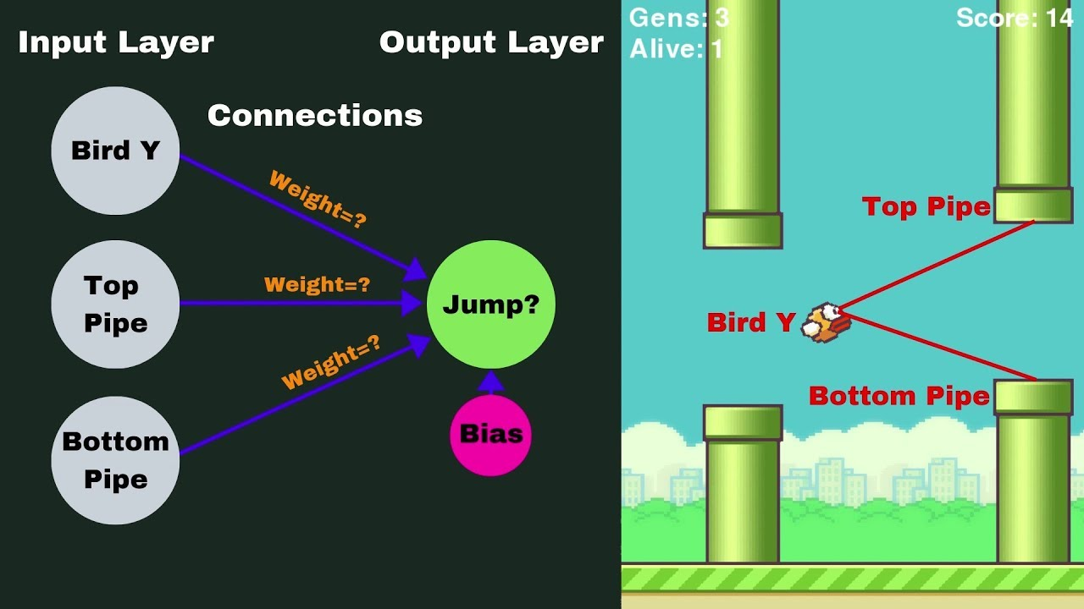
Capstone Project: Train an AI Agent to Play Flappy Bird
Presentation by The visionaries
Quyen dinh & Binte Zahra

Slide 3
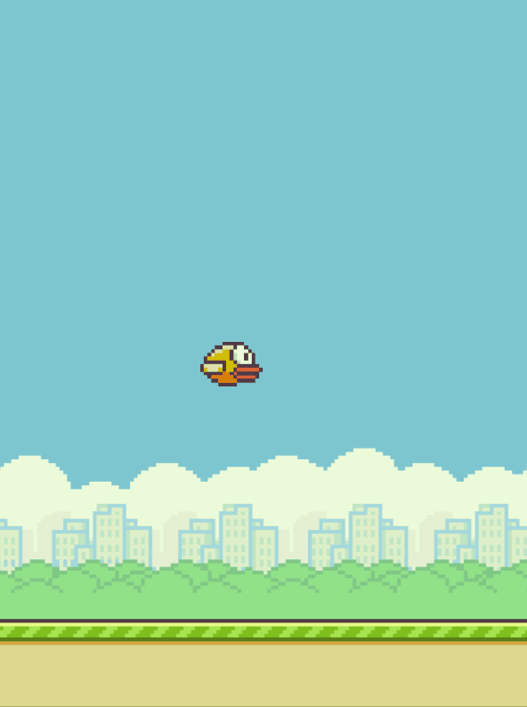
Project Overview
Train an AI agent to play Flappy Bird using reinforcement learning.
Combine computer vision for state representation and reinforcement learning for decision-making.
Demonstrates the application of RL in a dynamic, real-time environment.
Provides a foundation for understanding more complex AI challenges.

Slide 4
Key Components Overview
Environment Setup
Pre-trained Model Usage
Reinforcement Learning Implementation
Training
Evaluation

Slide 5
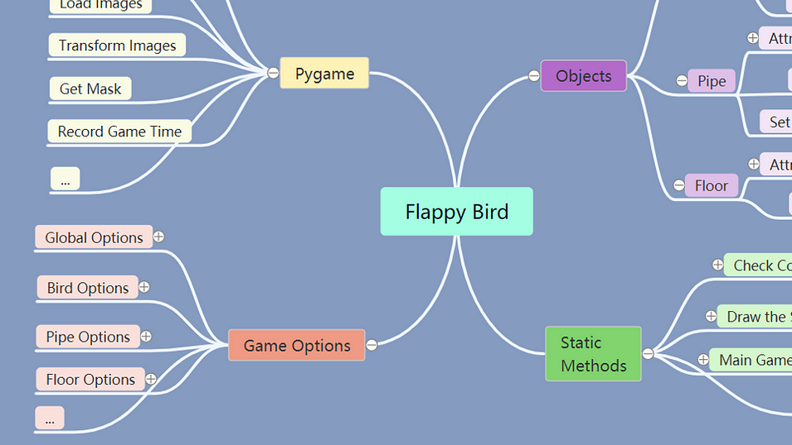
Environment Setup
Game Mechanics: Flappy Bird is a 2D side-scrolling game.The player controls a bird, navigating through pipes.
Tools:PyGame: Used for creating the Flappy Bird game environment.OpenAI Gym: Standardizes the interaction between the agent and the game.
State Representation: Game frames processed to grayscale, resized, and normalized.
Action Space: Two actions: flap or do nothing.
Reward System: Positive reward for passing pipes, negative reward for collisions.

Slide 6
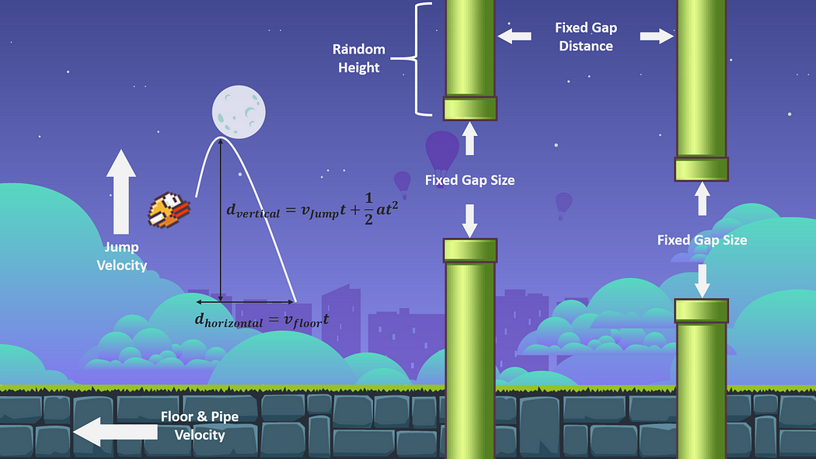
Pre-trained Model Usage
Transfer Learning:
Using a pre-trained MobileNetV2 model for feature extraction from game frames.
Why MobileNetV2?
Efficient model with a good balance between accuracy and computational cost.
Fine-tuning:
Adapting the pre-trained model to the specific features of Flappy Bird.
Notes:
Consider talking about:
Discontinuation
Legacy

Slide 7
Reinforcement Learning Implementation
Algorithm:Deep Q-Network (DQN): Combines Q-learning with deep neural networks.
Network Architecture:
Q-network: Estimates the action-value function.
Target Network: Helps stabilize training.
Policy:Epsilon-Greedy: Balances exploration and exploitation.
Experience Replay: Stores past experiences to break correlation and improve learning efficiency.
Notes:
Consider talking about:
Controversy and criticism

Slide 8
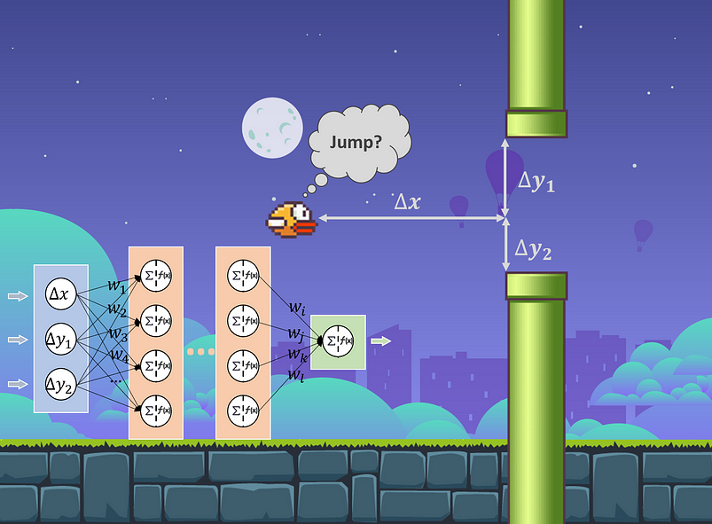
Training Process
Initialization:Q-network and target network are initialized.
Replay Memory:Experiences are stored and sampled during training.
Episodes:Each episode starts with resetting the game.
Action Selection:Actions are selected based on the epsilon-greedy policy.
Training Loop:Observing rewards, storing experiences, sampling mini-batches, and performing gradient descent.
Target Network Update:Periodically updating the target network to stabilize learning.
Notes:
Consider talking about:
Controversy and criticism

Slide 9
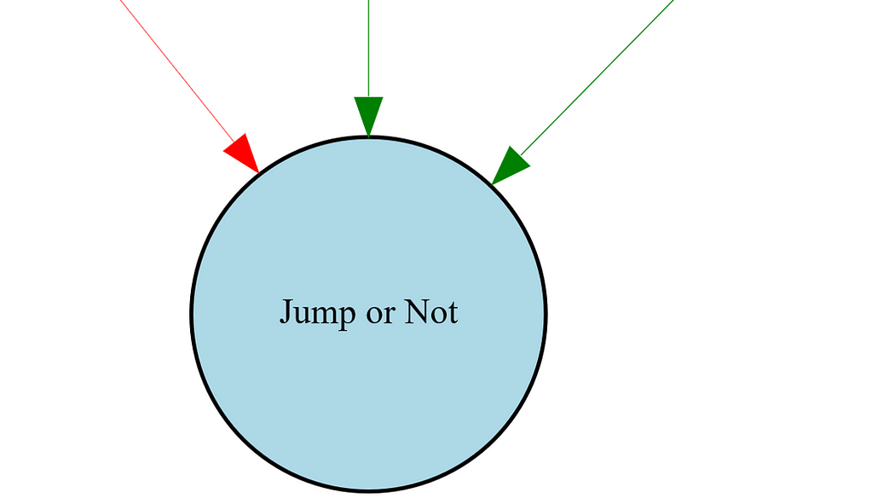
EVALUATION
Performance Metrics:Average Score:
Measures how well the agent performs.
Survival Time: How long the agent survives in the game.
Pipes Passed: Number of pipes successfully navigated.
Visualizations:
Learning curves to show progress over time.
Game frames demonstrating the agent's actions.
Notes:
Consider talking about:
Controversy and criticism

Slide 10
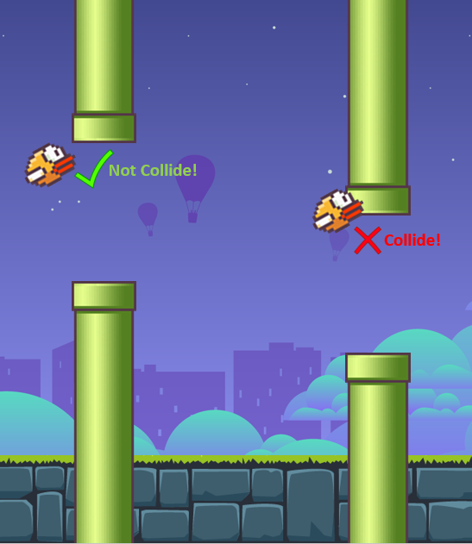
Key Learnings and Reflections
Challenges: Catastrophic forgetting and reward sparsity.
Mitigations: Target networks and experience replay.
Insights: Importance of balance between exploration and exploitation.
Future Work: Experimenting with advanced algorithms and varied reward structures.
Notes:
Consider talking about:
Controversy and criticism

Slide 11
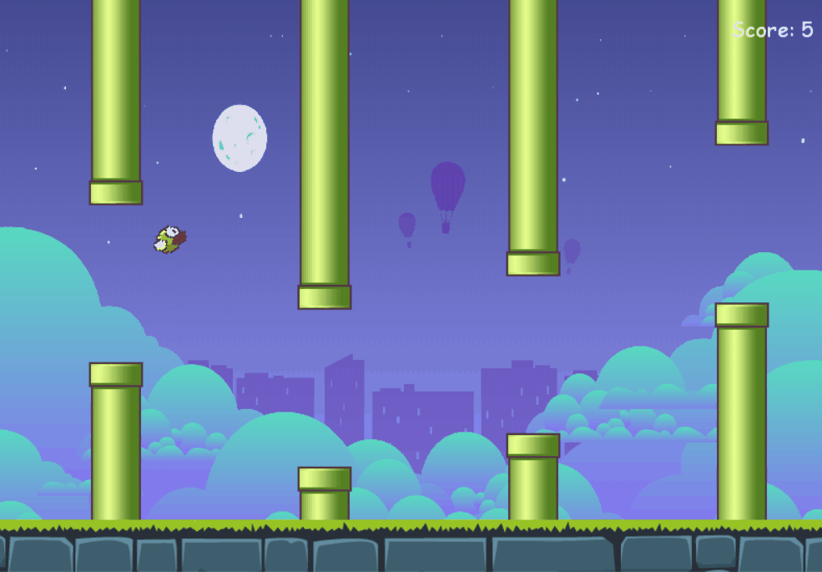
CONCLUSION
Quyen:
In conclusion, this project successfully demonstrated the use of reinforcement learning to train an AI agent for Flappy Bird.
We navigated through setting up the environment, using a pre-trained model, implementing DQN, and evaluating the agent's performance.
Binte Zahra:
The journey involved overcoming challenges like catastrophic forgetting and reward sparsity, providing valuable insights into practical reinforcement learning applications.
This experience has deepened my understanding of reinforcement learning and its potential in dynamic environments.
Notes:
Consider talking about:
Controversy and criticism

Slide 12
Works cited
https://medium.com/analytics-vidhya/how-i-built-an-ai-to-play-flappy-bird-81b672b66521
2003.09579v2 (arxiv.org)
taivu1998/FlapAI-Bird: An AI program that plays Flappy Bird using reinforcement learning. (github.com)
kevin-fang/reinforced-flappy-bird: Using deep reinforcement learning and policy gradients to train a neural network to play flappy bird (github.com)

